Slide 1
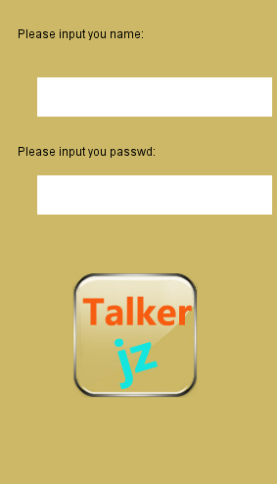


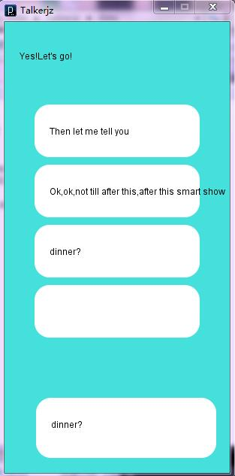



_{Talker 1.0}
_{Talker 2.0}
_{Talker 3.0}

Slide 2
_{Talker}
4.0

Slide 3

I am ……

Slide 4
Tip
system

Slide 5
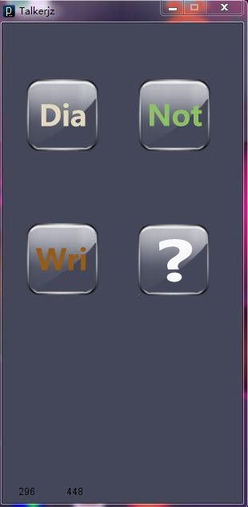
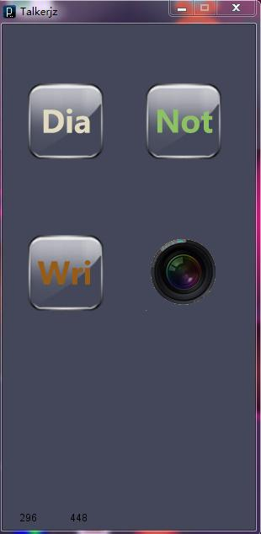
Pic
system

Slide 6
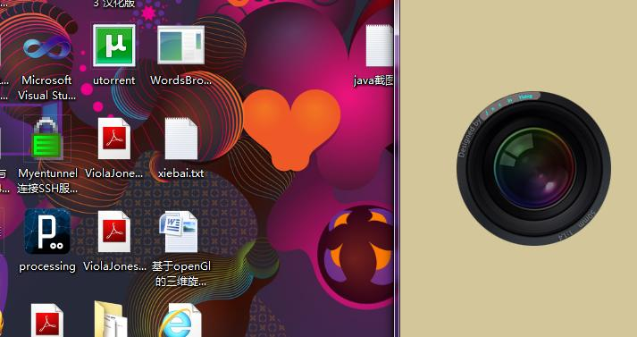
Pic system

Slide 7
we even expect
more

Slide 8
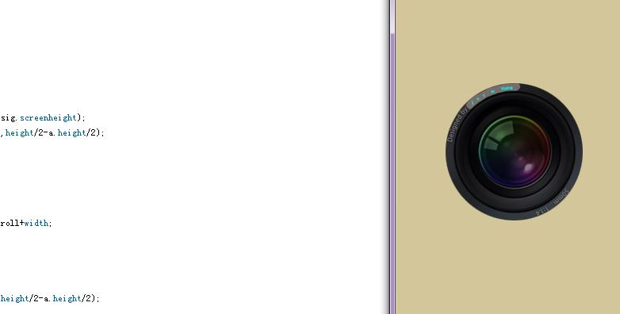
Ensure
safety

Slide 9
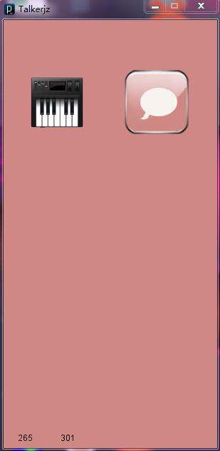
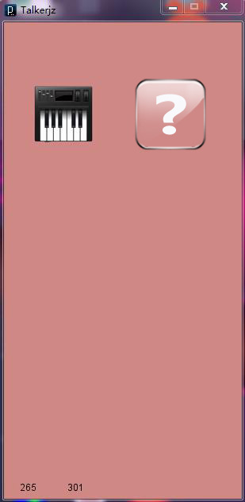
Ask

Slide 10
we even expect
more

Slide 11

Net

Slide 12
Demo

Slide 13
Thank you

